Slide 1

Project Title - Seasonal Agriculture Performance
Himani Mishra
Amrapali Group Of Institutes
AICTE STU ID : STU6a6a20fe82e5e1785340158

Slide 2

PROBLEM STATEMENT
Agricultural activities are influenced by seasonal variations in environmental conditions, farming practices, resource availability and market conditions. As a result, agricultural performance may differ from one season to another. However, raw agricultural data does not clearly explain how agricultural performance changes across seasons or what patterns can be observed in different seasonal conditions. The problem is to analyze the given agricultural dataset and investigate seasonal differences in agricultural performance by identifying meaningful patterns, trends, relationships and variations within the available data.

Slide 3
Project Description:
This project analyzes seasonal agricultural performance using a dataset of 4,000 farm records across Indian states. It explores how yield, profit, cost, and resource usage vary across the Kharif, Rabi, and Zaid seasons, using Python-based data cleaning, exploratory data analysis, and correlation techniques to uncover meaningful patterns and provide data-driven recommendations for improving agricultural outcomes.

Slide 4

WHO ARE THE END USERS?
Farmers seeking to understand seasonal profitability and better crop and irrigation choices.
Agricultural policy makers planning seasonal support and irrigation subsidy programs.
Agri-business analysts studying regional and seasonal performance trends.
Researchers studying seasonal farming patterns and resource efficiency.

Slide 5

Technology Used:
Pandas
NumPy
Matplotlib
Python
Seaborn

Slide 6
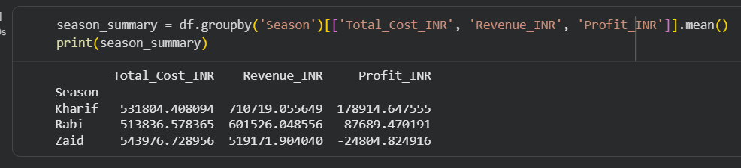
RESULT 1:
Season-wise averages show Zaid has the highest cost (Rs. 543,977) but the lowest revenue (Rs. 519,172), resulting in a negative average profit of Rs. -24,805. Kharif has a reasonable cost and the highest revenue (Rs. 710,719), giving it the strongest profit margin among all seasons.

Slide 7
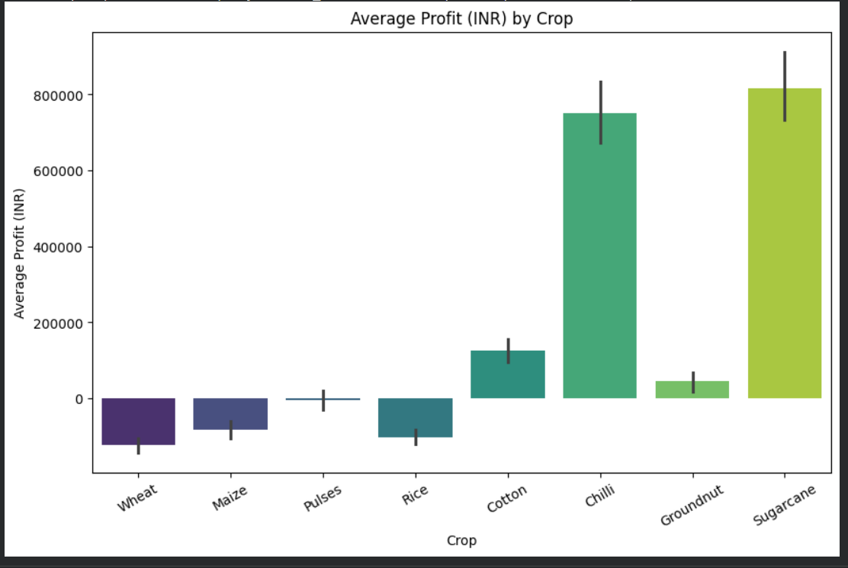
RESULT 2:
Sugarcane and Chilli are the most profitable crops, both averaging over Rs. 700,000 in profit, while Wheat, Maize, and Rice show negative average profit, meaning many farms growing these staple crops are operating at a loss.

Slide 8
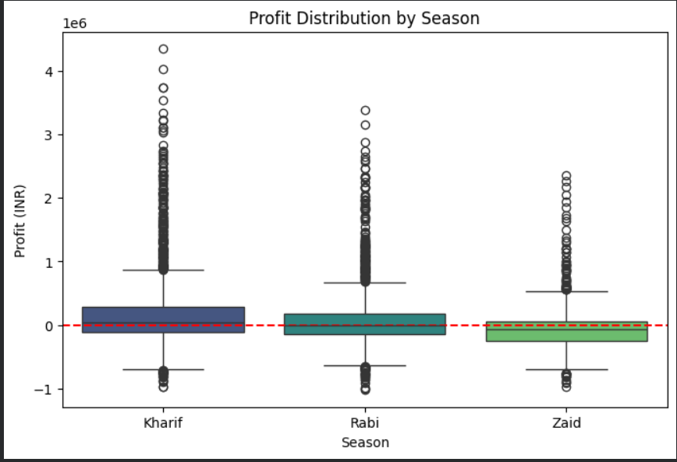
RESULT 3:
Profit varies widely within every season, with some farms earning over Rs. 40 lakh and others losing over Rs. 10 lakh. Kharif's median profit is clearly above zero, Rabi's is close to zero, and Zaid's median sits below zero, meaning more than half of Zaid's farms operate at a loss.

Slide 9
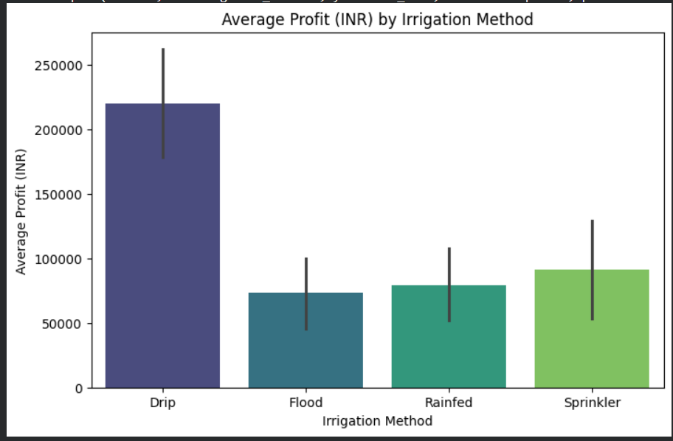
RESULT 4:
Drip irrigation gives the highest average profit (about Rs. 220,000), nearly triple that of Flood irrigation (about Rs. 73,000). This links directly to water efficiency, suggesting farmers using Flood irrigation could improve profitability by switching to Drip systems.

Slide 10
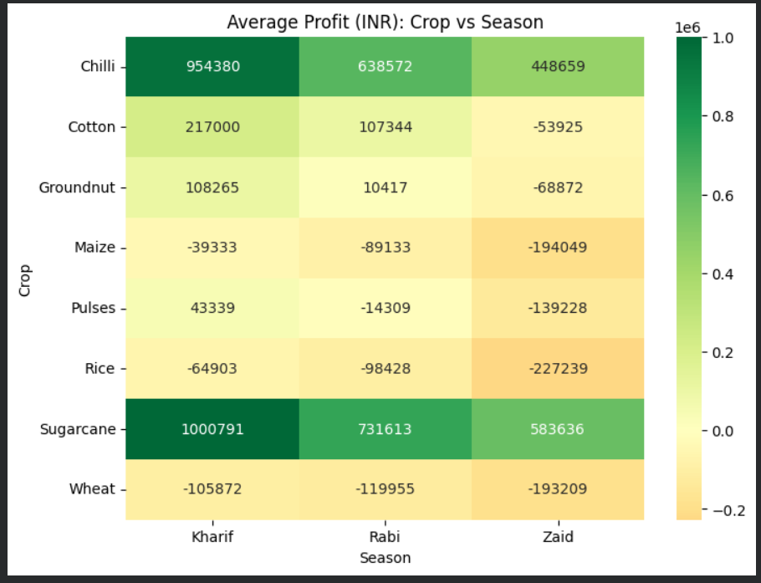
RESULT 5:
This heatmap shows that profit depends on crop choice and season together. Sugarcane in Kharif is the most profitable combination (about Rs. 10 lakh), while Rice, Wheat, and Maize remain loss-making in every season, with losses worsening in Zaid

Slide 11
Future scope:
This analysis can be extended by incorporating machine learning models to predict crop yield and profit based on seasonal and environmental factors. Integrating real-time weather data and building an interactive dashboard would further help farmers make more timely data-driven decisions across seasons.

Slide 12
GitHub Link:
https://github.com/himanimishra26-debug/Seasonal-Agriculture-Performance-Analysis.git

Slide 13

VOIS Course completion certificate - Course name- Data Visualization

Slide 14
Thank you
.
.

